Slide 1
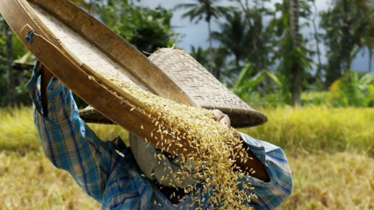
RICE CROP DETECTION
By Group 8

Slide 2

AGENDA
PROBLEM OVERVIEW & MOTIVATION
SUMMARY OF APPROACH
EXPLANATION OF RESULTS
METHODOLOGY
SUMMARY OF VALUE CASE
LEARNINGS
TAKEAWAY POINTS

Slide 3

PROBLEM OVERVIEW & MOTIVATION
Global Importance: Rice is a staple for over 4 billion people, but declining yield growth rates pose challenges.
Climate Impact: Climate change threatens rice production, with a forecasted 15% yield decrease in developing countries.
Motivation: Reducing food shortages, enhancing farming practices, and resolving issues with agricultural sustainability can all be accomplished.

Slide 4

DATA COLLECTION STRATEGY?
SATELLITE
DATA ANALYSIS
- OPTICAL + RADAR DATA
FACTORS:
Latitude & longitude co-ordinates
Harvest date
Intensity of rice cropping
Season of cultivation
Field size
Rice yield

Slide 5

SUMMARY OF APPROACH
First and foremost, leveraged satellite data.
Researched about phenology or vegetation growth pattern over time.
A set of metrics: precision, recall, accuracy, and R2 (coefficient of determination), would be constructed to assess model performance.
Built a classification model which can distinguish between rice and non-rice fields.
BUT WHICH PARAMETERS TO CONSIDER?

Slide 6
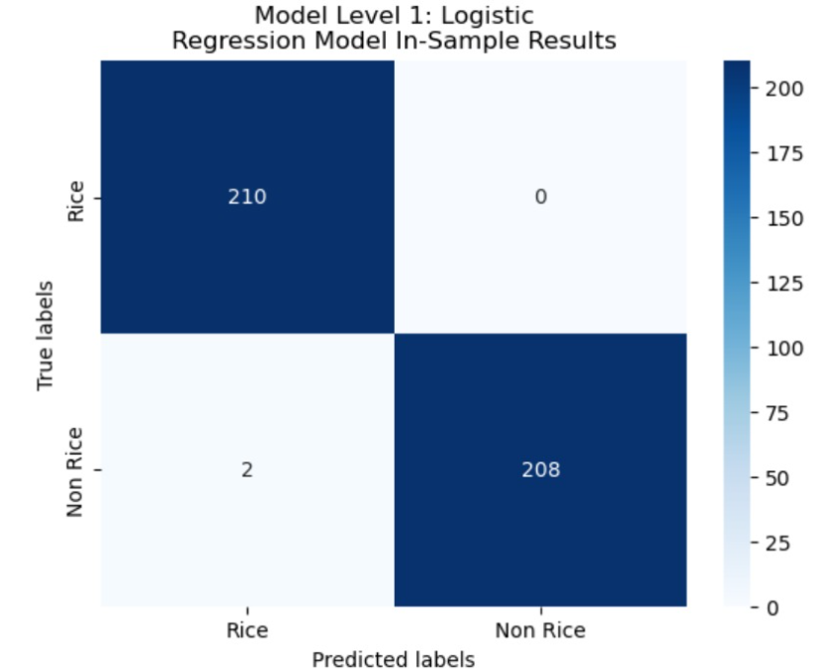
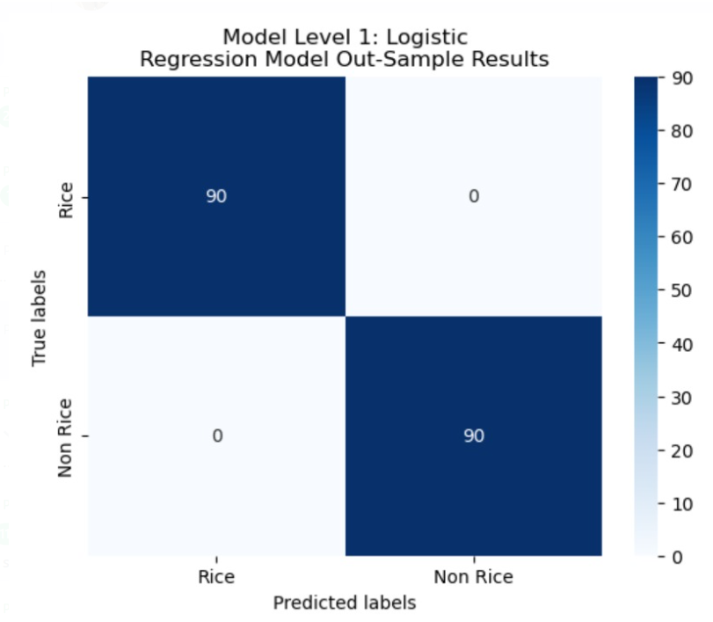
EXPLANATION OF RESULTS
TP
FN
FP
TN

Slide 7
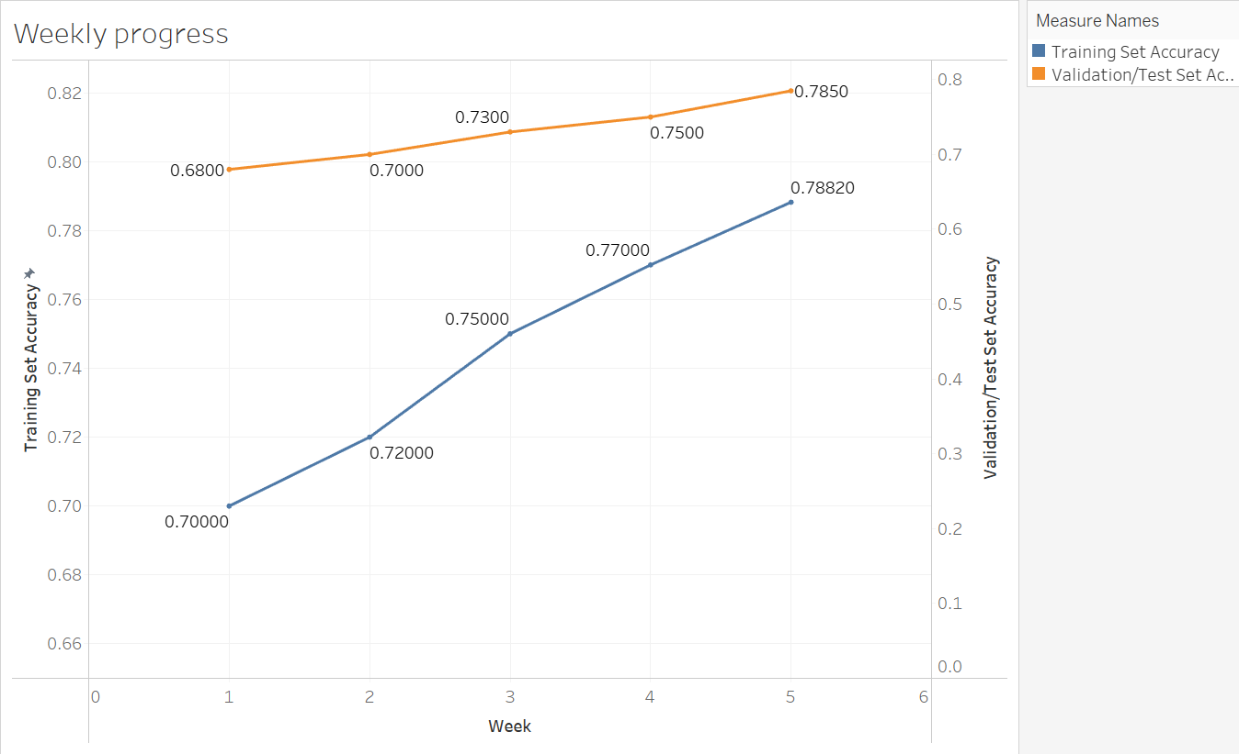
Week 5
Final Model
Week 4
LightGBM
Week 3
Random Forest
Week 2
Post Feature Eng
Week 1
Baseline Model

Slide 8

EXPLANATION OF RESULTS
The model's accuracy on the training and testing set steadily improved throughout the development stages.
Training Set Accuracy Progression:
70% with the baseline model and reaching 78.82% with the final model.
Insight: Increase in accuracy indicates that the model is learning from the training data and becoming more proficient at classifying rice crops.
Validation/Test Set Accuracy Progression:
Improved 68% with the baseline model and reaching 78.5% with
the final model.

Slide 9
EXPLANATION OF RESULTS
A smaller gap between training & test accuracy suggested that:
The model is not overfitting to the training data.
Effectively classify rice crops in new data instances.
Generalizes well with unseen data.

Slide 10

METHODOLOGY
Feature Engineering and Selection (WEEK 1):
Features like NDVI, elevation metrics, spectral data, and terrain data were integrated to enhance the model's performance.
Continuous experimentation with feature selection and transformation guided the refinement efforts.
Feature Impact: The incorporation of the NuSVC model and the exploration of different date ranges highlighted the critical role of temporal context in satellite data analysis.

Slide 11

METHODOLOGY
Hyperparameter Optimization (WEEK 2):
NuSVC model was integrated into the ensemble of models, leveraging its advanced decision boundary capabilities.
Fine-tuning parameters of models like LightGBM and NuSVC, the team optimized the model's performance and efficiency.
Feature Impact: The additional spectral indices, terrain attributes, and climatic variables had a significant impact on improving the accuracy.

Slide 12

METHODOLOGY
Utilization of Advanced ML Techniques (WEEK 3):
The team integrated advanced ML techniques such as K-NN, Random Forest, NuSVC, and LightGBM into the model.
Feature Impact: The strategic feature selection and transformation techniques contributed to the model's improved accuracy and robustness.

Slide 13
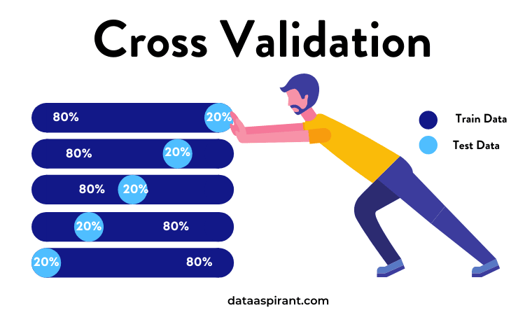
METHODOLOGY
Cross-Training with K-Fold Cross Validation (WEEK 4 & 5):
The team balanced in-sample and out-of-sample errors to improve predictive accuracy of the LightGBM model.
Feature Impact: Adjustments to boosting type, learning rate, feature fraction, bagging frequency, and maximum depth, further optimized the model's accuracy.

Slide 14

SUMMARY OF VALUE CASE – Business Applications
Supply Chain Optimization
Identify most efficient routes for transporting rice
Minimizes fuel consumption, reduces transportation time, and avoids traffic congestion
Resource Allocation
Implement irrigation techniques to optimize water usage and reduce waste
Ensure crops receive appropriate nutrients and pesticides
Sustainable Policy Development
Use evidence-based decision making to prioritize interventions to address issues
Support SDG Sustainable Development Goals

Slide 15

SUMMARY OF VALUE CASE – Business Case
Monetize through strategic licensing agreements
Generates revenue and establishes long-term partnerships with key stakeholders
Next phase of the project: predicting rice yields for each field detected
Further optimizes resource allocation, minimizes costs, and enhances productivity
Anticipate and mitigate risks associated with market volatility, climate variability

Slide 16

LEARNINGS
Technical Skills:
Hyperparameter Optimization: Fine-tuning model parameters to improve predictive accuracy and efficiency.
Temporal Analysis: Recognizing the significance of temporal factors in satellite data analysis and seasonal trends in agricultural data.
Ensemble Techniques: Integrating multiple models for improved decision-making and classification accuracy.

Slide 17

LEARNINGS
Teamwork:
Communication: Establishing effective communication channels and regular team meetings to discuss progress and action items.
Collaboration: Leveraging individual strengths and expertise to drive the project forward.
Knowledge Sharing: Sharing insights and learnings from individual research and experiences to enhance the collective understanding.

Slide 18

LEARNINGS
Project Management:
Iterative Approach: Embracing an iterative approach to model refinement and feature selection based on continuous experimentation.
Documentation: Maintaining detailed records of progress, learnings, and outcomes for future reference and analysis.
Future Planning: Setting clear goals for ongoing model refinement, exploring novel modeling approaches, and validating the model's performance for real-world applications.

Slide 19

TAKEAWAY POINTS
Precision Through Advanced Models: Utilizing advanced ML models , coupled with comprehensive feature engineering, enhances precision and accuracy.
Temporal Insights for Informed Decisions: Understanding the significance of temporal factors in satellite data analysis and seasonal trends provides deeper insights into agricultural practices. Contextual data is key.
Continuous Model Refinement for Real-World Impact: Continuous model refinement, feature selection, and validation exercises are crucial for improving predictive accuracy and model performance.

Slide 20
THANK YOU!

